Slide 1
SPDC LOD1 Health Check – Forcados Area
Manage Threats and Opportunities
Final Report
24th October 2022
Kebin Ofori
Manager, Reliability Engineering
MTO Site Process Owner (SPO)
Victor Ndukwe
Onshore Reliability Engineer – West Asset
MTO Site Process Focal Point (SPFP)

Slide 2

Appreciation
Thank you ALL for your:
Virtual Hospitality
Sharing
Transparency
Cooperation
Asset Manager | Maichibi, Meshach - West Asset Manager
Sponsor | Kebin Ofori - Manager, Reliability Engineering/MTO SPO
Asset Management Integration | 1. Uduanochie, Ada - AMIL West Asset 2. Busari, Abiodun -West Project Ops Mgr 3. Michael Ezebuiro/Sotonye Georgewill - West Asset Support
Focus PUMs | 1. Godwin Udoh - Forcados Area Production Unit Manager 2. Tunde Akinro - Forcados Area Production Unit Manager
Reliability Engineers/MTO SPFPs | 1. Victor Ndukwe - Reliability Engineer - Forcados Area 2. Nzenwa Rita - Snr AMS Change Implementation Supervisor
Interviewees | Production Team 1. Godwin Udoh/ Tunde Akinro - Forcados Area Production Unit Managers 2. Agboola, Olufemi/Chidebelu, Clement/Jacks, Dapriye - OPS T/Ls 3. Ude Raphael/Ekeocha Chinedu - Mtce T/Ls 4. Liberty, Gesi/Samuel Eriagbon, Egodo Edward- NBK MTO SPFPs 5. Ononogbu Harry - Mtce Supv 6. Nelson Odien - OPS Supv/MTO SPFP 9. Simon Edache - Elect Supv 10. Debo Oluyoye - PACO Supv WRFM Team 11. Boniface Nnogo - Well Integrity Lead WRFM 12. Chiroma Barka - Princ Process Engr/WRFM Focal Point 13. Aguye, Dansuleiman - WRFM Well Delivery Adviser 14. Ebogomo Noah - FMT Southern Swamp

Slide 3

Objectives
Collect direct observations and feedback about how the process is being executed – strengths, weakness and gaps.
Reinforce the importance of the process and process results.
Coach people on Site Process Owner expectations and process execution
Identify what parts of the process need improvement and where in the asset improvement is needed.
Identify practices worth replicating.

Slide 4
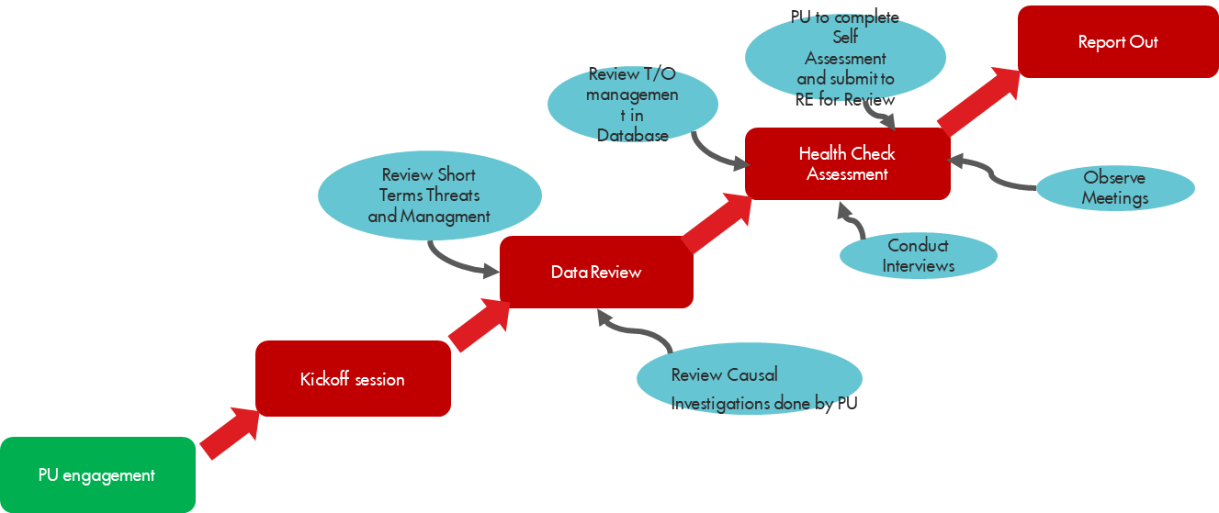
Recap of Scope and Methodology – Forcados Area
Leadership, Commitment & Accountability
Evidence will be based upon sampling of available information, not all-inclusive or exhaustive to verify the identified improvement opportunities.
Scope
Leadership, commitment and accountabilities – servant leadership & sustainable organizational capability
MTO organizational structure – effective Production Team, active PUM ownership, and segregation between ST and LT T/O management.
T/O Identification – single repository for all LT T/O
Prioritize and Select – value-focused prioritized list of T/O
Organizational Capability for Problem Solving – strong causal reasoning capability & capacity, problem solving at various levels of complexity (Frontline, PT and EPST)
Opportunity Framing – of value proposition which maximize return on investment
Take Action – clear ownership, budget and execution plan
Learn and Improve – outcomes of effectiveness assessments are shared/discussed, proactive review of external learnings and include into MTO where applicable.
Strong interfaces with other key AMS work processes.
Requirements, Processes & Guides
Organisational Capability
Learning Loops
Resources:
Inhouse expertise
MTO Process Health Check template to gather information.

Slide 5
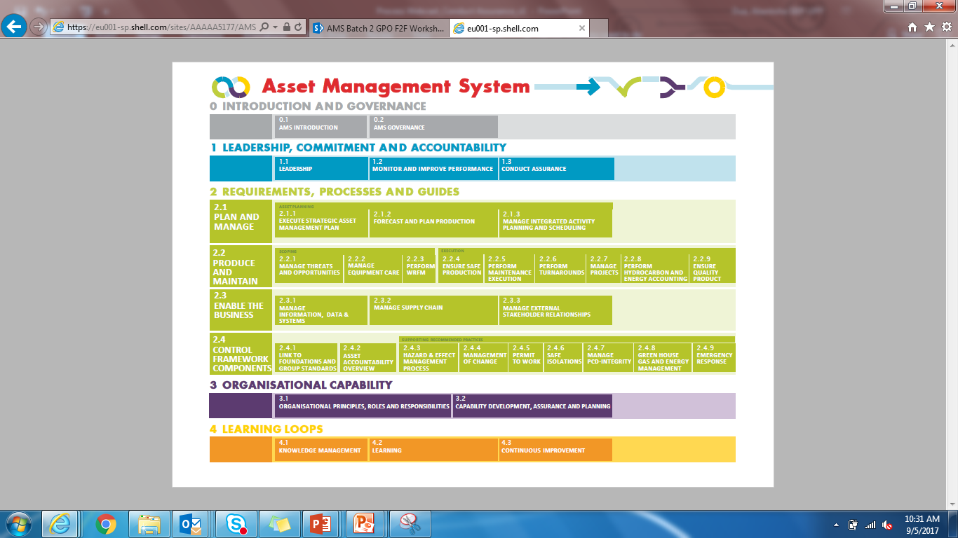
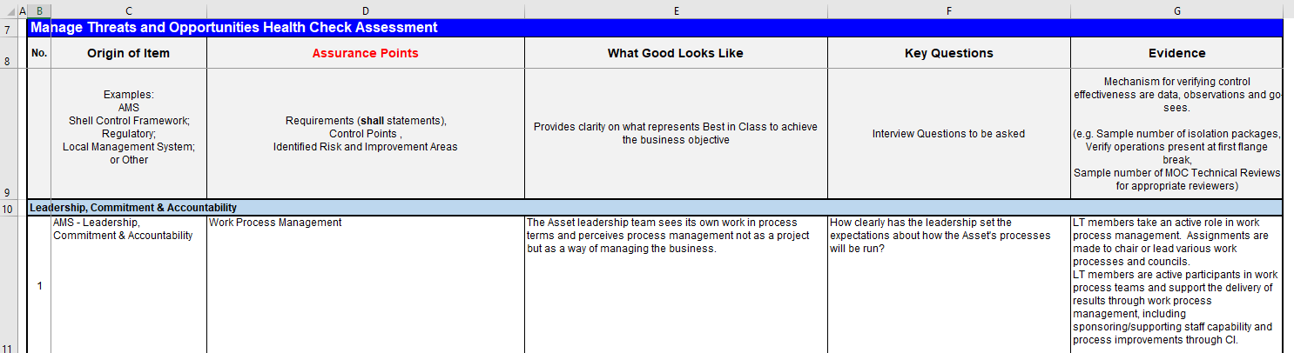
LOD1 Health Check Observations
39 Assurance Points were assessed across all 4 AMS pillars.
15 out of 39 Assurance Points are requirements (‘shall’).
26 Assurance Points meet the intent.
Remaining 13 of which 8 are ‘shall’ requirements have areas for improvement opportunity.
Scope
(APs 1&4): Leadership, commitment and accountabilities – servant leadership & sustainable organizational capability – Weekly Meetings
(APs 11, 14 & 15): MTO organizational structure – effective Production Team, active PUM ownership, and segregation between ST and LT T/O management.
(AP 18, 24, 25): T/O Identification – single repository for all LT T/O (WFRM Opportunities management & PTM)
Prioritize and Select – value-focused prioritized list of T/O
Organizational Capability for Problem Solving – strong causal reasoning capability & capacity, problem solving at various levels of complexity (Frontline, PT and EPST)
(AP 18): Opportunity Framing – of value proposition which maximize return on investment
(APs 28 & 29): Week interfaces with other key AMS work processes.
Take Action – clear ownership, budget and execution plan
(AP 38): Learn and Improve – outcomes of effectiveness assessments are shared/discussed, proactive review of external learnings and include into MTO where applicable.

Slide 6

Strength observed
Good governance & LMS – Demonstrated commitment to all relevant AMS processes. Competence on the MTO process was also demonstrated by all interviewees lead by the PUM.
PU LT walks the talk – shared vision & priorities, commitment in the use of process assurance (internal health check) & MTO KPI to manage risk and deliver business targets.
MTO Focal Points showed high sense of ownership of the process, praised by interviewers.
Active Bad Actor management – Zero Repeat Trip ambition is great, with commitment from all levels in the PU.
Process performers understood how the process connects with expected business outcomes.
Best practice adopted in the training of personnel on the use of Causal Reasoning for low/medium impact threats and establishment of an EPST to investigate high impact threats.
Appreciable number of 5WHYs investigation done with staff showing good understanding of the causal investigation process
Threats and Opportunities are in single database with clear ownership and action accountabilities.

Slide 7

Weakness observed
Weekly MTO meetings: very weak in terms of frequency and attendance.
Timely closure of threats (actions) occasioned by budget, workload, knowledge of the MTO process.
Short Term Threats management: not impressive and needs to be matured.
Early threat identification and mitigation: Frontline plays an inactive role.
Updating WRFM Opportunities: no evidence of update for loaded opportunities.
Involvement of support teams in MTO process (WRFM, Asset Support Engineering, ME, Well, etc): Very weak. Having better understanding of AMS process
Threats owned by external party: No traction on the threats. Most times they are managed by site teams.
Critical production equipment not connected to remote monitoring devises
Learn and improve is not evident in the PU. Regular cross sharing and learning on ‘GO SEEs’, internal health check assessment and best practices to improve the process and business performance.
Active Leader Involvement

Slide 8
Final Action Plan
The Production Unit Leadership and MTO SPO are accountable for ensuring adequate and timely response to the identified improvement opportunities.
S/No. | Gaps Identified / Findings | Recommended Improvement Opportunities | Action Owner | Target Close out date
1 | Meetings hold occasionally - not in line with the Standard Manual PUM or his designate to preside over the meeting with all members (as stipulated in the Meeting Term Of Reference) in attendance on a regular frequency | 1. Develop workable plan for weekly MTO meeting (PUM) 2. Hold MTO meeting regularly with PUM or his designate presiding while ensuring attendance of all required membres 3. Conduct Refreshers Course on AMS Process for Asset Support Engineering | 1. PUM 2. PUM 3. Mike Ezebuiro | 1. 31/10/2022 2. 31/10/2022
2 | No evidence of 'GO SEE' report for process improvement. | 1. Arrange for a 'GO-SEE' for team members to learn what other PUs are doing. 2. Create a SharePoint repository for all ' MTO go-see' reports. | 1. PUM 2. MTO FP | 1. 31/12/2022 2. 31/12/2022
3 | Appointment letters not made available for all staff occupying MTO critical positions | Prepare, sign and issue an appoiintment letter to all persons occupying MTO critical positions including WRFM Focal Points. | MTO SPO/ Reliability Engineer | 30/11/2022
4 | 1. There was no virtual board to aid online ST review. 2. Record of closed ST not maintained | 1. Develop and put into use a vistual White Board for managing the STs 2. Maintain record of completed STs by creating a TAB on the virtual White Board | 1. MTO FP 2. MTO FP | 1. 31/10/2022 2. 31/10/2022
5 | Few T/O for PU, Subsurface, WRFM | 1. Capture relevant WRFM opportunities in the SAP-OM into Fit4MTO tool. 2. Update the captured Opportunities on regular basis. | 1. Ebogomo Noah 2. Ebogomo Noah | 1. 28/2/2023 2. 30/11/2022
6 | Absence of Remote monitoring tools i.e SmartConnect, EBS, PTM. | Deploy PTM and other remote monitoring tool for proactive monitoring. | PTME Lead | 30/9/2023
7 | Align the prioritization of WRFM opportunities with MTO process applying the 50% threshold as stated in MTO/WRFM Interface Document | Engage the WRFM Leadership of these teams to determine the threats and opportunities to be loaded into the MTO. | Aguye Dansuleiman | 30/11/2022
8 | 1. Interface between WRFM opportunities and Fit4MTO is somewhat weak and needs to be strenghtened. 2. New WRFM opportunities were identified and loaded on quarterly basis as per the set criteria. However these opportunities are not followed up to maturation in the tool. 3. STOG activites and PSOs are being worked by relevant teams but still not captured and loaded in Fit4MTO tool. | 1. Engage the SPO for WRFM, ME, ESP, MSC, MEC to work out modalities to strengthen the interface relationship. 2. Identify support team FPs and Opportunities owners and coach them on the MTO process and opportunity management using the Fit4 tool. 3. Identify accountable person and ensure STOG activities and PSOs are captured, loaded and progressed to closure using Fit4MTO | 1. MTO SPO 2. Relaibility Engr 3. Aguye Dansuleiman | 31/1/2023 30/1/2023 3.30/11/2022
9 | Include closed actions effectiveness review in the MTO meetings agenda. Threshold is on threats closed in the last three months. | Include closed actions effectiveness review in the Weekly MTO meetings agenda. | MTO FP /Reliability Engineer | 30/11/2022

Slide 9
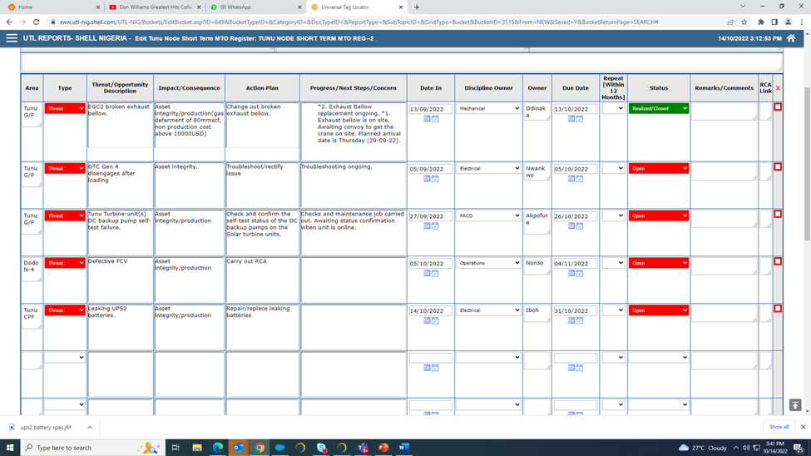
Good Practices – Sample Whiteboard for STs from Tunu

Slide 12
WEST ASSET WEEKLY MTO meeting - tOr
MEETING PURPOSE |  | Provide a forum to review critical issues impacting on Asset Reliability, Flaring and Deferment. Prioritize issues on Fit4MTO such that resources are focused in the right area.
ATTENDEES |  | Production Unit Manager/Terminal Installation Manager/Offshore Installation Manager, Operations TL/Supervisor, Maintenance TL/Supervisor, Maintenance Support; AGG Engineer, Operation Support, Asset Engineering support, MTO Focal points, Reliability Engineer, HSSE Adviser (as required), Well Services, Programmer, Production Chemistry
FREQUENCY | Weekly | Duration | 1 Hr/0.5 Hr (as agreed)
TIME & LOCATION |  | Every agreed weekday ; Time: TBA ; Venue: TBA
AGENDA |  | Activity |  | Who | Time (mins)
 |  | 1. People recognition |  | All | 10/5
 |  | 2. Review of Issues with Medium and High Impact on: Proactive Threats/Opportunities identification Unscheduled Deferment & Flaring Repeat Equipment failure & Bad actors Other impact on Asset Integrity and Reliability Review of Process trips |  | MTO FP/RE | 10/5
 |  | 3. Updates on RCAs and Corrective action plans. |  | RCA/CL Leads | 10/5
 |  | 4. Active (and Overdue) Threat and Opportunity Review |  | All | 10/5
 |  | 5. Either of: Fit4MTO T/O risk profile Monthly reliability performance insights MEC and MTO KPI review Learning from reliability incidents |  | MTO FP/RE | 10/5
 |  | 6. Emerging Threats and AOB |  | All | 10/5
INPUTS: Deferment & Flaring summary. Repeat failures & Bad actors. Trip reports & Reliability Performance. Fit4MTO |  | OUTPUTS: - Incidents that require a formal RCA Corrective actions and other action items. Savings and Loss Avoidance via MTO Updates to Fit4MTO threats and opportunities |  |  | RULES: - Action owners to provide actions update before the meeting. - Keep to time

Slide 13
Improvement Opportunity
No. | Origin of Item | Assurance Points | Gaps Identified / Findings | Recommended Action Items
Leadership, Commitment & Accountability
1 | AMS - Leadership, Commitment & Accountability | Work Process Management | Gap exist. - Meetings hold occasionally which is not in line with the Standard Manual PUM or his designate to preside over the meeting with all members (as stipulated in the Meeting Term Of Reference) in attendance on a regular frequency | 1. Develop workable plan for weekly MTO meeting (PUM) 2. Hold MTO meeting regularly with PUM or his designate presiding while ensuring attendance of all required members 3. Conduct Refreshers Course on AMS Process for Asset Support Engineering
4 | AMS - Leadership, Commitment & Accountability | Work Process Management | No evidence of 'go-see' report. | 1. Arrange for a GO-SEE for Focal Points and TLs to learn from what other PUs are doing. 2. Create a SharePoint repository for all ' MTO go-see' reports.
1.1 MTO Organisational Structure
11 | MTO Standard 1.1.1 MTO RP Section 5 | Each site shall have Production team(s) that manage short- and long-term threats and opportunities. | Appointment letters not made available for all staff occupying MTO critical positions | Prepare, sign and issue an appoiintment letter to all persons occupying MTO critical positions including WRFM Focal Points.
1.2 Short Term Threats and Opportunities
14 | MTO Standard 1.2 MTO RP 2.7.1 | As part of the daily meetings, the Production Team shall identify, make visible, assign ownership, expected completion dates, and track actions for all short-term threats and opportunities. | 1. There was no virtual board to aid online ST review. 2. Record of closed ST not maintained | 1. Develop and put into use a virtual White Board for managing the STs 2. Maintain record of completed STs by creating a TAB on the virtual White Board
1.3 Long Term Threats and Opportunities
15 | MTO Production Standard 1.3 MTO RP 2.7.2 | The Asset shall identify, record in the MTO tool, prioritize and select, problem solve, take action and build organizational alignment for all long-term threats and opportunities. | Few T/O for PU, Subsurface, WRFM and Pipeline | 1. Capture relevant WRFM opportunities in the SAP-OM into Fit4MTO tool. 2. Identify, capture and load all relevant PU and Subsurface T/O in the Fit4MTO (as detailed in MTO Local Management System). 3. Identify Threats & Opportunity, capture and load all relevant Pipeline T/O in the Fit4MTO process.
2.3.1 Identify Threats and Opportunities
18 | MTO Manual 2.3.1.3 MTO RP 2.7.1, 2.7.2 Structure and Resources | Newly identified threats and opportunities shall be made visible to relevant stakeholders: · Short term - Daily Meeting visualization, e.g. whiteboard, and Long term - MTO tool. | 1. There was no virtual board to aid online ST review. 2. Record of closed ST not maintained 3. Non WRFM opportunities captured | 1. Develop and put into use a virtual White Board for managing the STs 2. Maintain record of completed STs by creating a TAB on the virtual White Board 3. Capture non WRFM facility improvement opportunities into the MTO process.
2.3.5 Learn and Improve
24 | MTO Manual 2.3.5.1 MTO RP 2.6 | Solutions shall be validated to ensure that they have delivered the intended outcome. | Absence of Remote monitoring tools i.e SmartConnect, EBS, PTM. | Deploy PTM and other remote monitoring tool for proactive monitoring
25 | MTO Manual 2.3.5.2 MTO RP 2.7.2 | Production Unit/Operations Manager shall be responsible for validating that the mitigations to address the threat have been effective. | 1. Absence of Remote monitoring tools i.e SmartConnect, EBS, PTM. 2. Opportunities not captured and progressed in MTO | 1. Deploy PTM and other remote monitoring tool for proactive monitoring. 2. Ensure opportunities are captured, entered in tool and progressed.
Manage Threats and Opportunities Work Process Interfaces
28 | Key work processes: ESP, HEMP, T/A, WRFM, MEC, ME, Projects | Understanding of Interfaces | Align the prioritization of WRFM opportunities with MTO process applying the 50% threshold as stated in MTO LMS or update LMS to reflect adopted agreed practice by MTO SPO and WRFM SPO | 1. Engage the Leadership of these processes (Process Safety, Wells, Development/Subsurface) to determine what threats and opportunities can be integrated into the MTO. 2. Capture non WRFM facility improvement opportunies into the MTO process.
29 | Key work processes: ESP, HEMP, T/A, WRFM, MEC, ME, Projects | Quality of Interfaces | 1. Interface between WRFM opportunities and Fit4MTO is somewhat weak and needs to be strengthened. 2. New WRFM opportunities were identified and loaded on quarterly basis as per the set criteria. However these opportunities are not followed up to maturation in the tool. 3. STOG activities and PSOs are being worked by relevant teams but still not captured and loaded in Fit4MTO tool. | 1. Engage the SPO for WRFM to work out modalities for improvement. 2. Identify support team FPs and Opportunities owners and coach them on the MTO process and opportunity management using the Fit4 tool. 3. Identify accountable person and ensure STOG activities and PSOs are captured, loaded and progressed to closure using Fit4MTO
Learning Loops
38 | AMS Continuous Improvement RP | Continuous Improvement | Include closed actions effectiveness review in the Asset MTO meetings agenda. Threshold is on threats closed in the last three months. | Include closed actions effectiveness review in the Asset MTO meetings agenda.

